Slide 1
A random and speedy paper review
1/26/2018

Slide 2
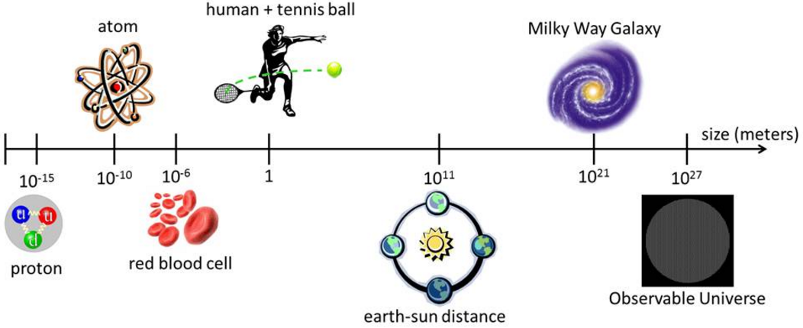
Quantum physics, AMO
Condensed matter
Cosmology and astronomy

Slide 3
Length scale mismatch due to diffraction limit!!

Slide 4
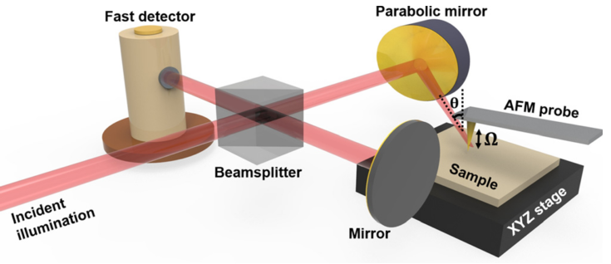
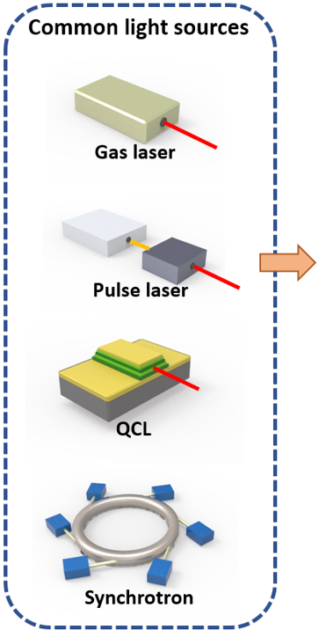
Scattering-type scanning near-field optical microscope (s-SNOM)
Michaelson interferometer
Focusing optics
Atomic force microscope (AFM)
A quantitative approach
to nano optics
02/06/2018

Slide 5
Anderson suggested that random potential fluctuations superimposed in a periodic lattice structure can produce a wide variety of electronic eigenstates that span from diffusive to localized states.
It was found that localization could also occur in classical waves, such as electromagnetic waves (photons).
Previous experimental evidence regarding photon localization is, however, predominantly based on macroscopic and collective data.
A class of metal-insulator (MI) transitions in those percolative thin metal films can be modeled as the random placement of electrical connections on an infinite grid.
As $p$ increases from 0 to 1, an electrically connected pathway across the grid eventually forms and the overall system transitions from insulating to conducting. This transition occurs at a critical probability $p_{c}$ whose value depends on various factors such as system dimensionality, the correlation between each sites, etc.
Previous experimental evidence regarding percolation is, however, predominantly based on macroscopic and collective data.

Slide 6
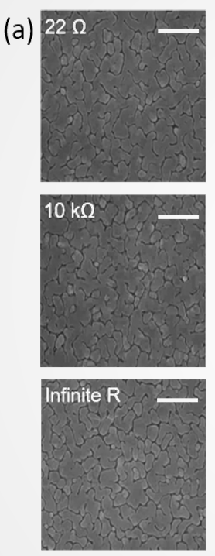
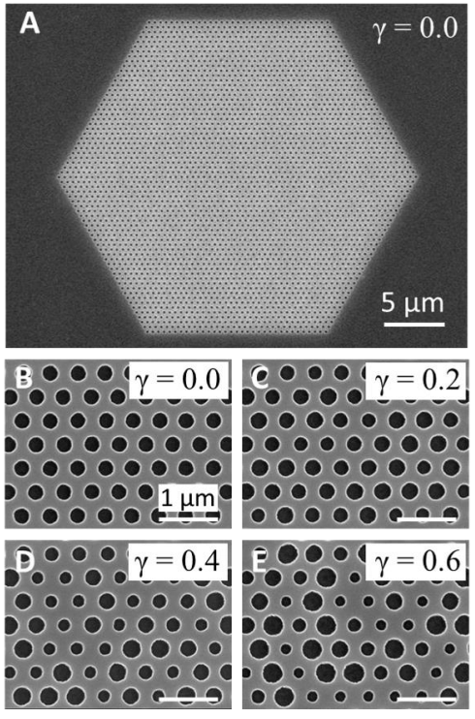
2D photonic crystal alloy
Radom gold film

Slide 7
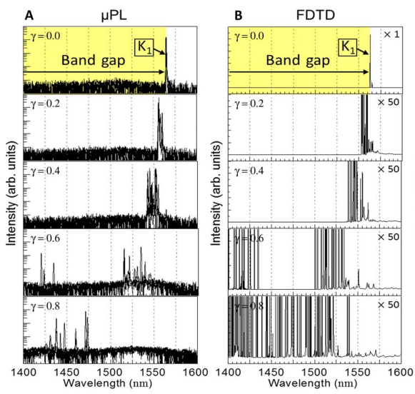
µPL
FTIR

Slide 8
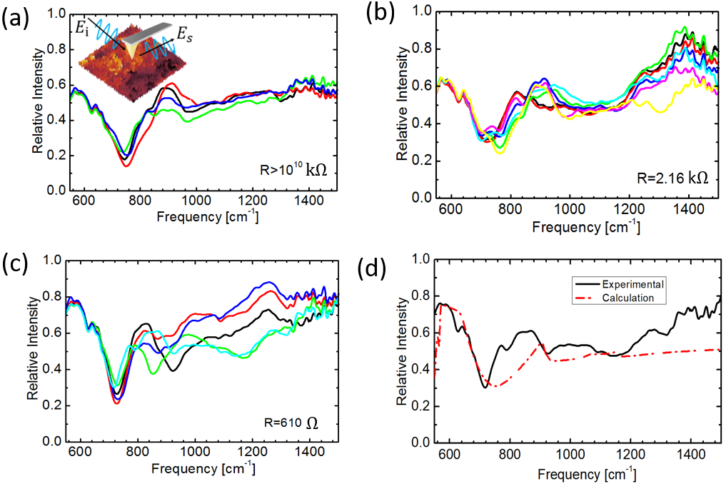
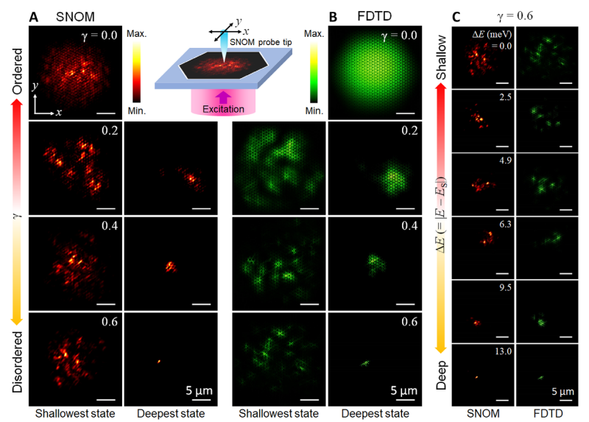
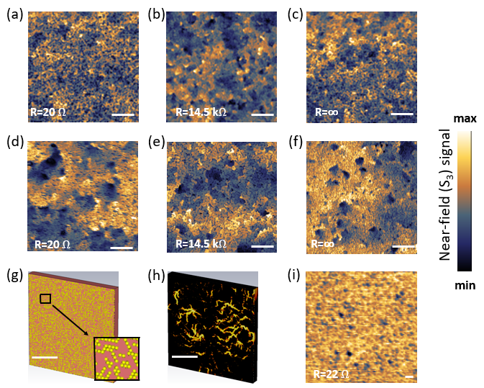

Slide 9
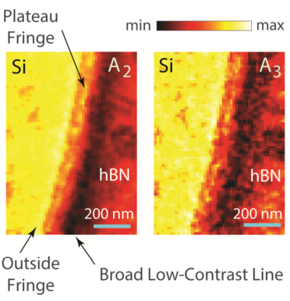
In s-SNOM experiments, near-field fringe formation at the sample edge is a rather complicated phenomenon
Possible reasons: excitations of edge states and resonances in the structure; Image artifacts due to feedback-related issues during rapid scanning around edges

Slide 10
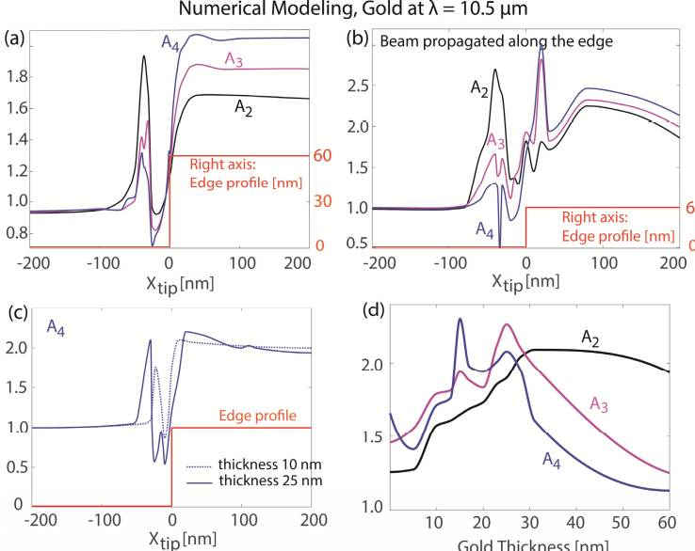
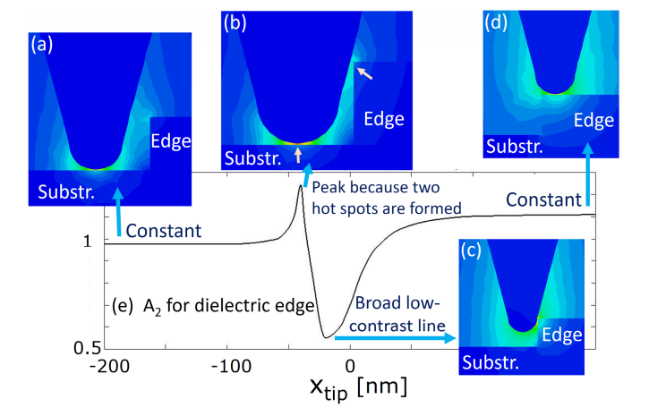

Slide 11
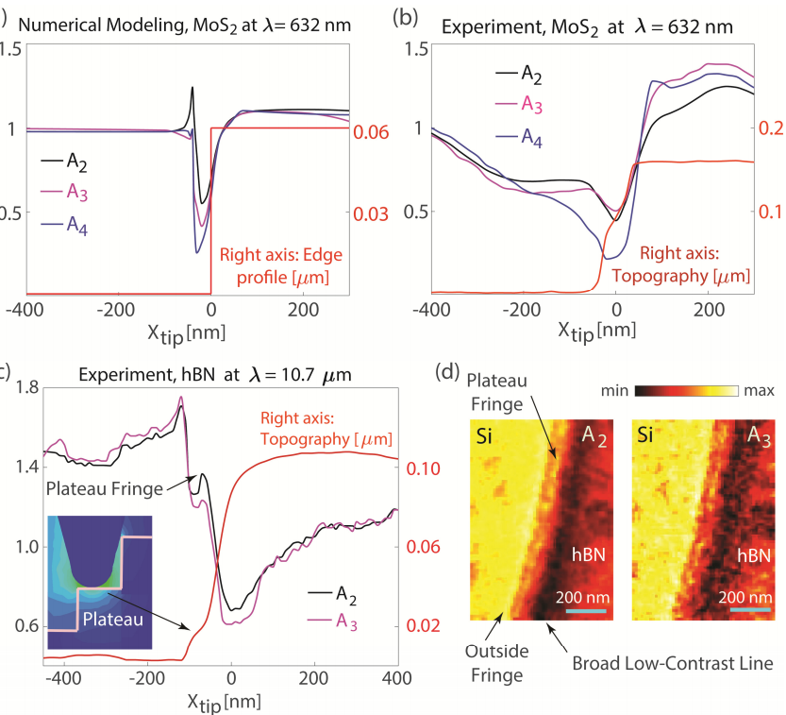
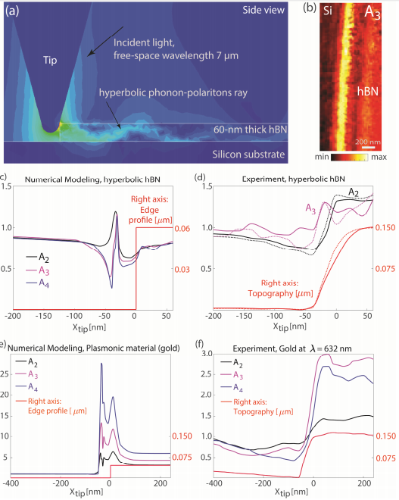

Slide 12
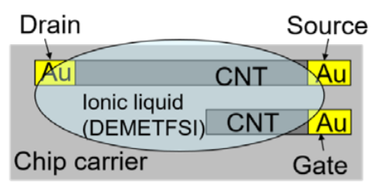
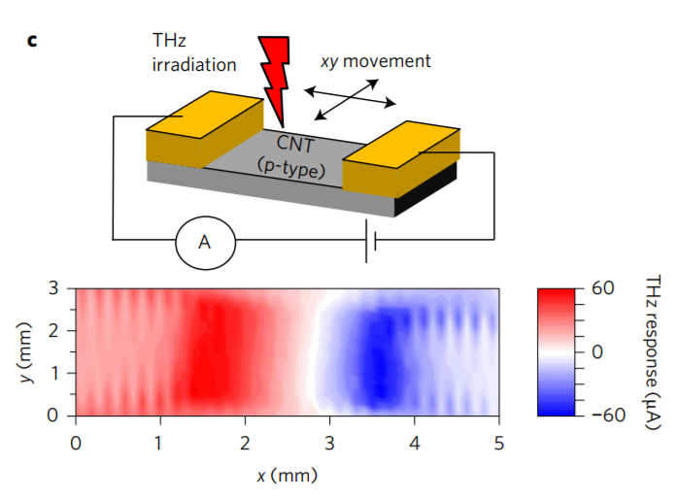
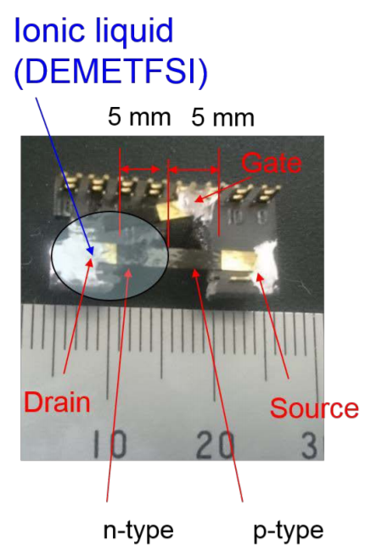

Slide 13
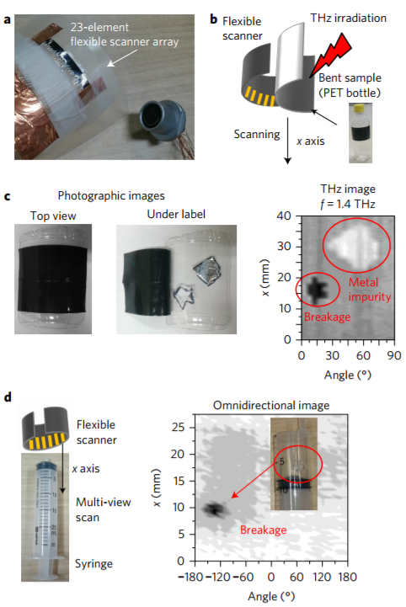
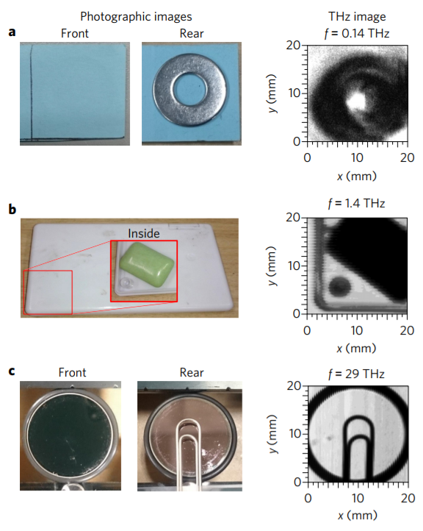

Slide 14
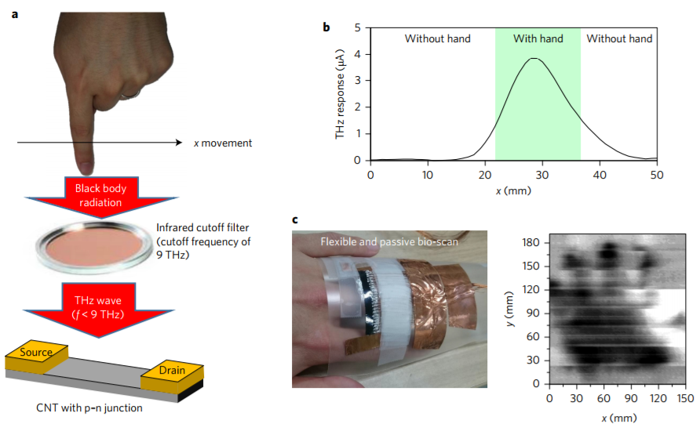

Slide 15
