Slide 1
All about the back and forth of the permittivity
And obviously… have to bring up some random stuffs

Slide 2
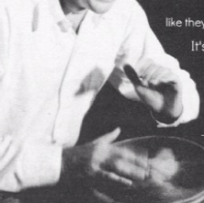
Feynman technique

Slide 4
Challenges
The near field of an s-SNOM tip extends to depths of ∼100 nm below the sample surface. A single s-SNOM image provides insufficient data for volumetric reconstruction.
Due to the mathematical characteristics, inversion (i.e., the mathematical procedure that recovers sample properties from the near-field data) is highly unstable in the presence of noise.
Recommended reading: Epstein, C. L.; Schotland, J. C. The Bad Truth about Laplace's Transform. SIAM Rev. 2008, 50, 504–520.

Slide 5
Theory
We begin by developing a general model of the scattering process that occurs when a s-SNOM tip is placed near a transversely homogeneous medium of permittivity ε.

Slide 6
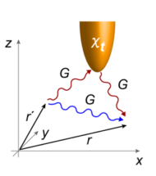
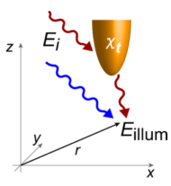
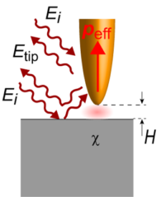
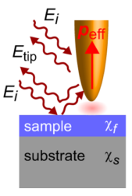
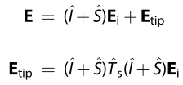
Theory
Cast the equation into an integral form with the aid of the Green tensors
A formal solution can be obtained using a Born series

Slide 7
Theory
Within quasistatic approximation
Considering only the harmonics for which the background is sufficiently suppressed
Essentially, we found and the goal is .

Slide 8
Inversion procedure
For samples composed of weak molecular oscillators does not significantly exceed
unity

Slide 9
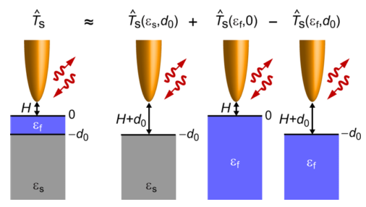
Theory
Now let’s consider the case of film on substrate.

Slide 10
Inversion procedure
For samples composed of weak molecular oscillators does not significantly exceed
unity

Slide 11
Key idea
Compute film permittivities from a pair of near-field contrasts and parametrized by a thicknesses parameter d.
In an ideal experiment, the difference is zero when evaluated at d corresponding to the correct film thickness. In practice, d0 can be found by minimizing the discrepancy between permittivities derived from different harmonics

Slide 12
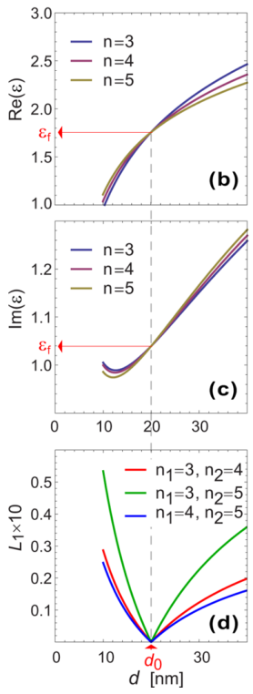
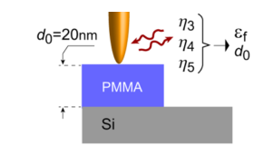
Demonstrations Simulated inversion

Slide 13
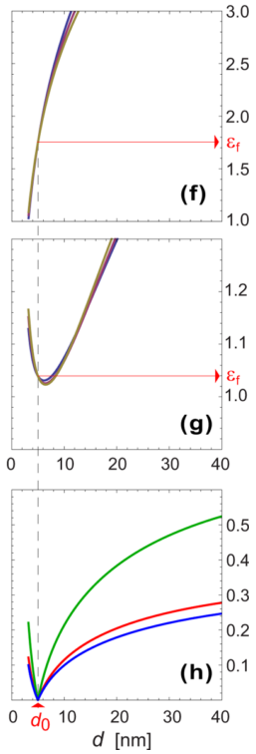
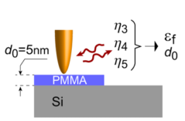
Demonstrations Simulated inversion

Slide 14
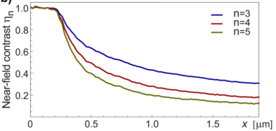
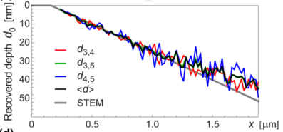
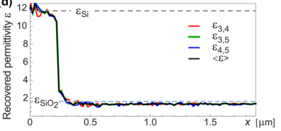
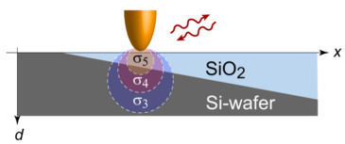
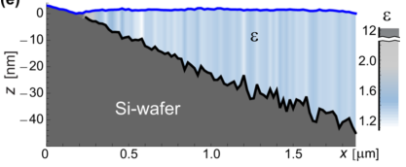
Demonstrations Determination of SiO2 film thickness from experimental data

Slide 15
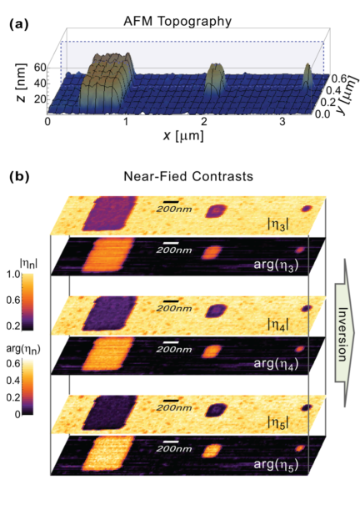
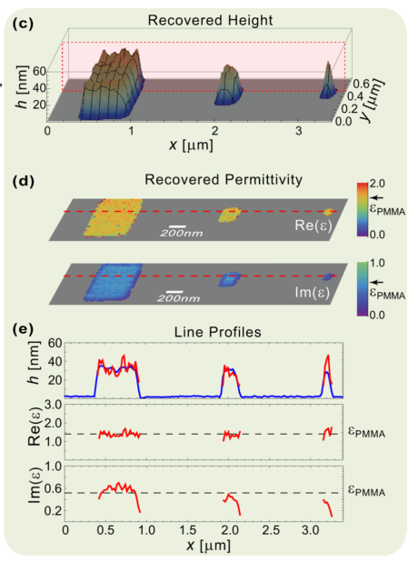
Demonstrations Inversion for nanostructured samples

Slide 16
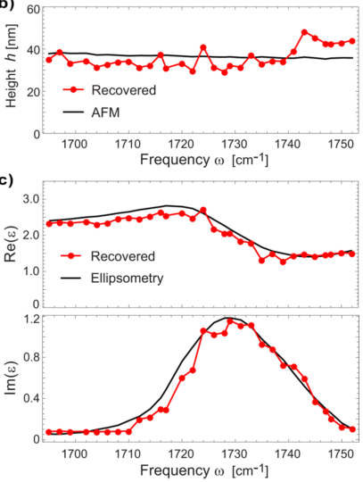
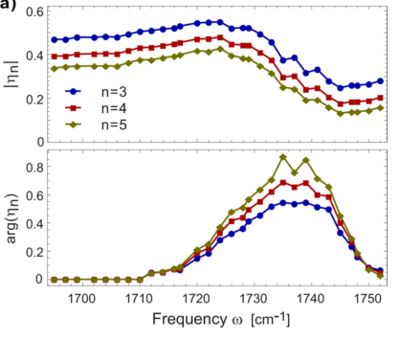
Demonstrations Spectroscopic reconstructions

Slide 18
Introducing…
Multi-harmonic
Infrared
Near-field
Translator

Slide 19
A user-friendly analysis system that bridges sample’s optical property (permittivity) and near-field-related experimental data in both directions based on the most advanced theoretical model available currently (cone model) with supplemental far-field analysis tools, providing quantitative physical interpretations of the observed phenomena in near-field related experiments, giving aid to data analysis, and providing simulation platforms in a relatively time- and cost-efficient way, without any requirements on users’ mathematical capability.

Slide 20
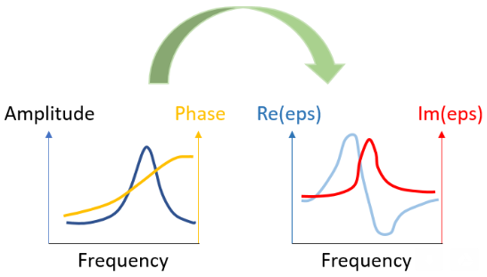
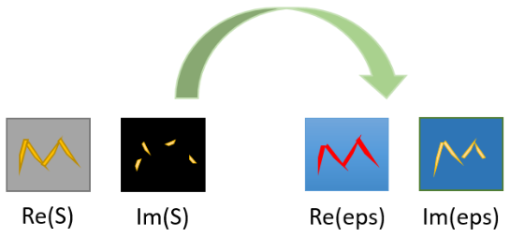
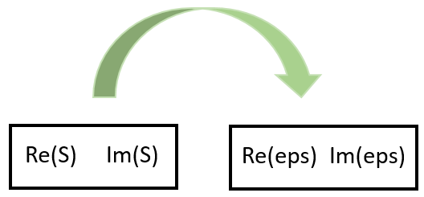
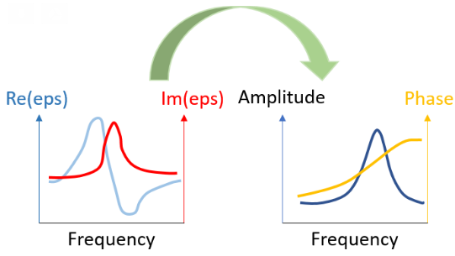

Slide 22
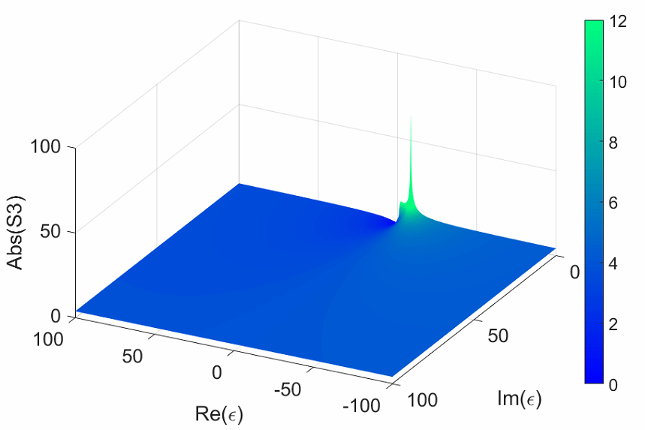
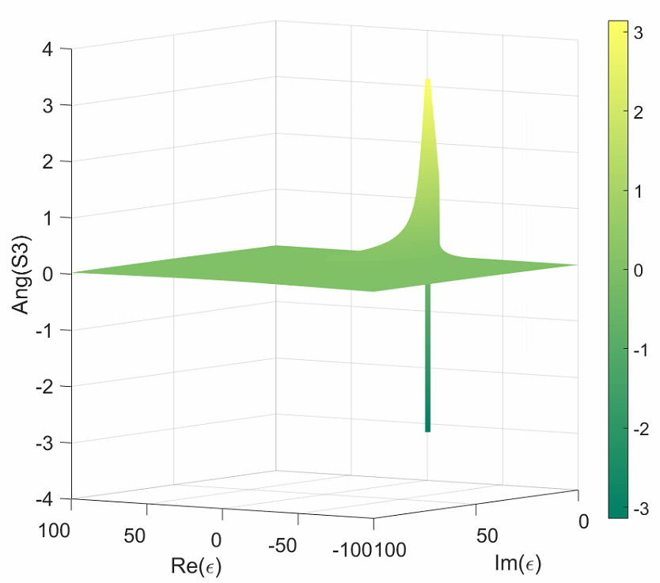
Numerical inversion

Slide 24
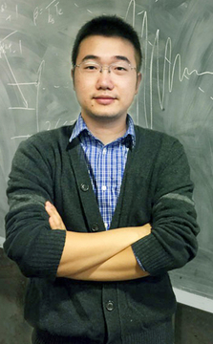
Advantages
Not limited to non-resonant regime
More complex models can be considered
User-friendly (it has a refreshing minty interface)
Less time-efficient
Requires a large database
Hard to perform on layered structure without prior knowledge
Disadvantages
VS

Slide 26
The next big thing: march toward the THz gap and cryogenic environment

Slide 27
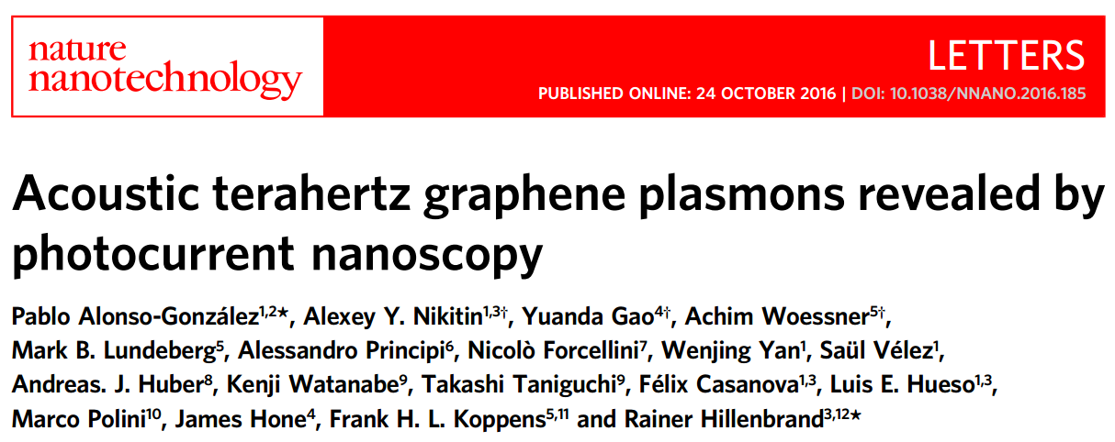
Trailer 1
Ziheng Yao
10/27/2017

Slide 28
Trailer 2
Kuangyi Xu/ Zhijing Niu
10/27/2017

Slide 29
Multi-harmonic Interpretation for Near-field at THz

Slide 30
Thank you sitting over this long-ish talk

