Slide 1
Random talk about coin toss and dipole above surface

Slide 2
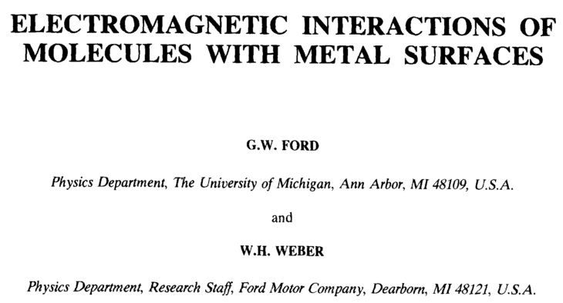

Slide 3
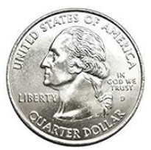
$3
$2
Alice
Bob
$2
$1

Slide 4
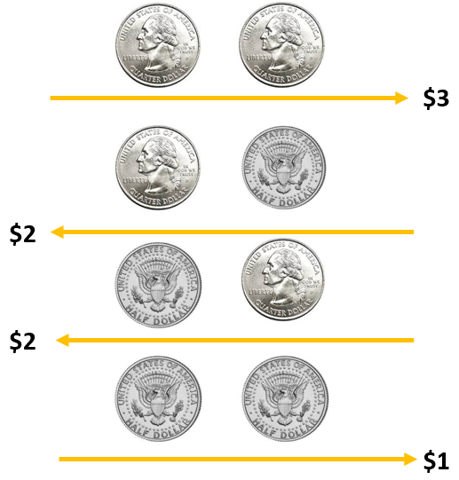
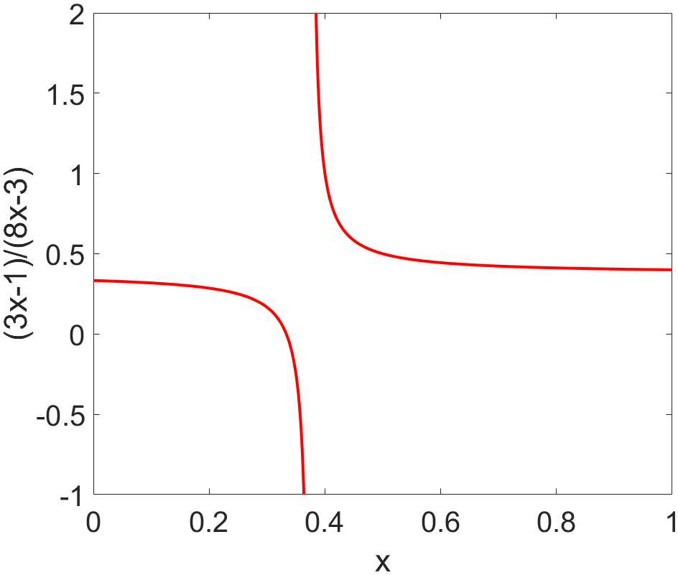
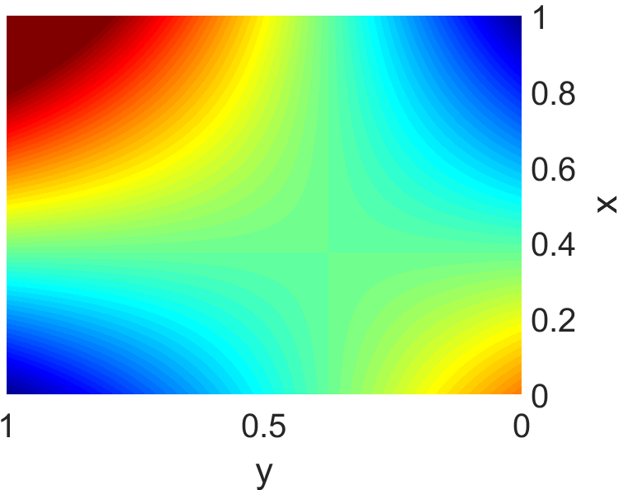
Hidden asymmetry in the seemingly symmetric system!
$$E\left(x,y\right)=3xy+1×\left(1−x\right)\left(1−y\right)−2x\left(1−y\right)−2y(1−x)$$
$$=8xy−3x−3y+1$$
$$y$$
$$1−y$$
$$x$$
$$1−x$$
$$=(8x−3)y−3x+1$$
$$\left(8x−3\right)y−3x+1<0$$
$$x,y∈[0,1]$$
$$\left(8x−3\right)y<3x−1$$
If $8x−3>0, i.e. x>\frac{3}{8},$
$$y<\frac{3x−1}{8x−3}$$
$$y<\frac{2}{5}$$
$$y>\frac{3x−1}{8x−3}$$
$$y>\frac{1}{3}$$
If $8x−3<0, i.e. x<\frac{3}{8},$
$$\frac{1}{3}<y<\frac{2}{5}$$

Slide 6
EM background
Assume
Continuity equation
For local medium:
For nonlocal medium:

Slide 7
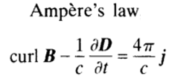
Fresnel Equation for local medium
For P-polarized wave,
$$p$$
$$ε_{1}(ω)$$
$$q_{1}$$
$$k$$
$$p$$
$$q_{2}$$
$$ε_{2}(ω)$$
$E_{par}$ and $B_{per}$ are continuous
Similarly,

Slide 8
Reflection by a nonlocal medium- the SCIB model
P-polarized
$$p$$
$$ε_{1}(ω)$$
$$q_{1}$$
$$k$$
$Z$ is continuous
$$p$$
$$q_{2}$$
$$ε_{2}(ω,k)$$
The calculation of the surface impedances depends upon the description of the medium below the surface.
For a metal the simplest approach that includes the features of nonlocality is the semiclassical infinite barrier (SCIB) model.

Slide 9
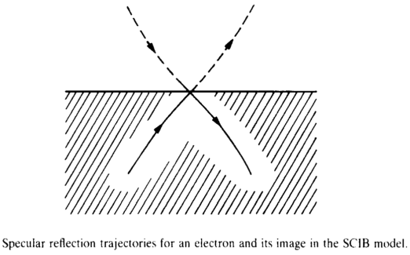
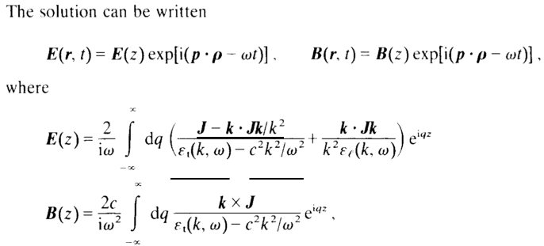
Reflection by a nonlocal medium- the SCIB model
Assume specular reflection of the conduction electrons at the metal surface.
The conduction electrons are treated as a classical ideal gas, but with Fermi—Dirac statistics.
Then, from a consideration of the Boltzmann equation for the electrons, one sees that when the reflection is specular, the fields within the metal half-space are identical to the fields in an infinite metal arising from a source corresponding to a current sheet at the surface.

Slide 10
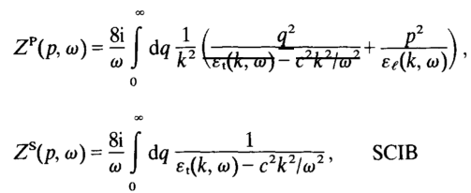
Reflection by a nonlocal medium- the SCIB model

Slide 11
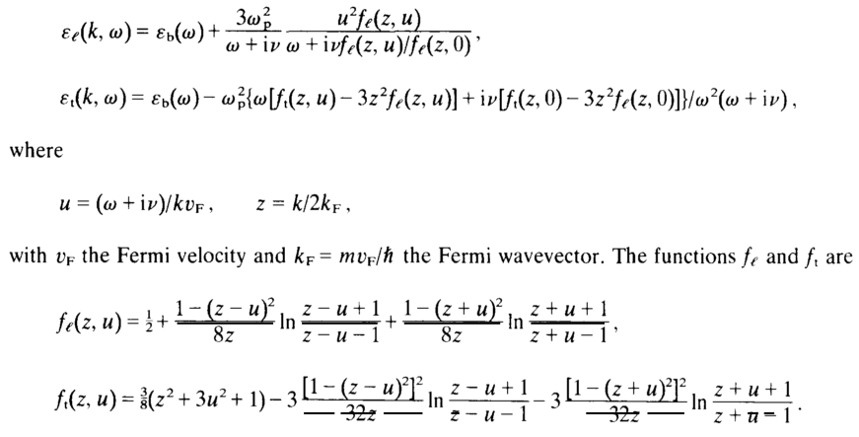
Reflection by a nonlocal medium- the SCIB model
It has become customary to extend the model by using instead the quantum infinite medium dielectric constants.

Slide 12
Quasi-static approximation
The zeroth-order quasi-static equations are obtained by formally setting $c=∞$ in Maxwell’s equations.
In next order the terms of order $c^{−1}$ are kept in Ampere’s law, and the magnetic field is determined from
$$r_{12}^{S}=0$$

Slide 13
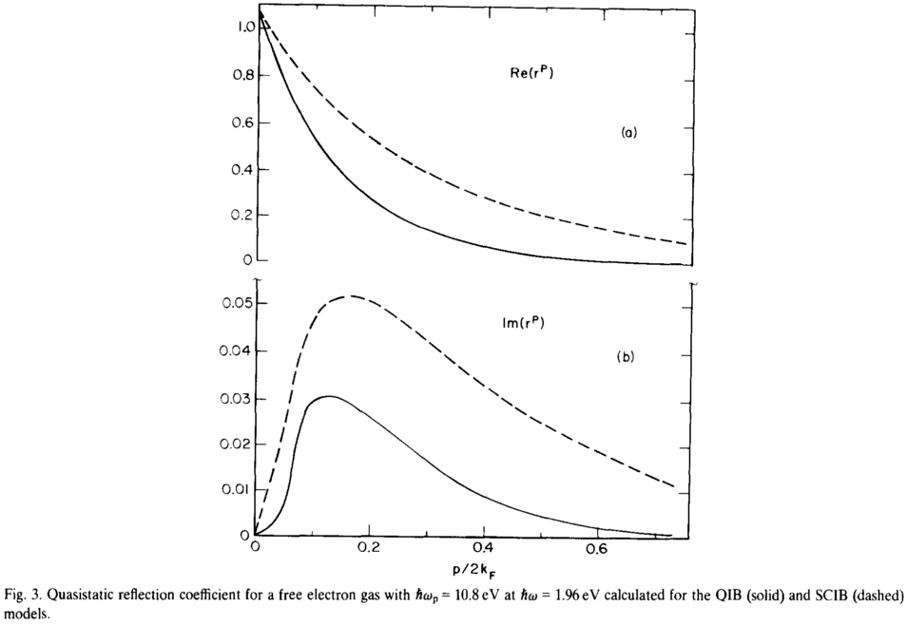
Reflection by a nonlocal medium- the QIB model
Consider an ideal quantum gas of electrons filling a half-space with an infinite potential barrier at the surface.
Assume that the background dielectric constant is unity and that the electron collision frequency is vanishingly small. We derive the linear response of this system to electric fields in the quasi-static approximation.

Slide 14
Reflection in the long-wavelength limit
The wavelength should be long compared with the Fermi wavelength
The phase velocity of the waves be large compared with the Fermi velocity
$$p$$
$$ε_{1}(ω)$$
$$q_{1}$$
$$k$$
$$ε_{2}^{′}(ω,k)$$
$$p$$
$$q_{2}$$
$$ε_{2}(ω)$$

Slide 15
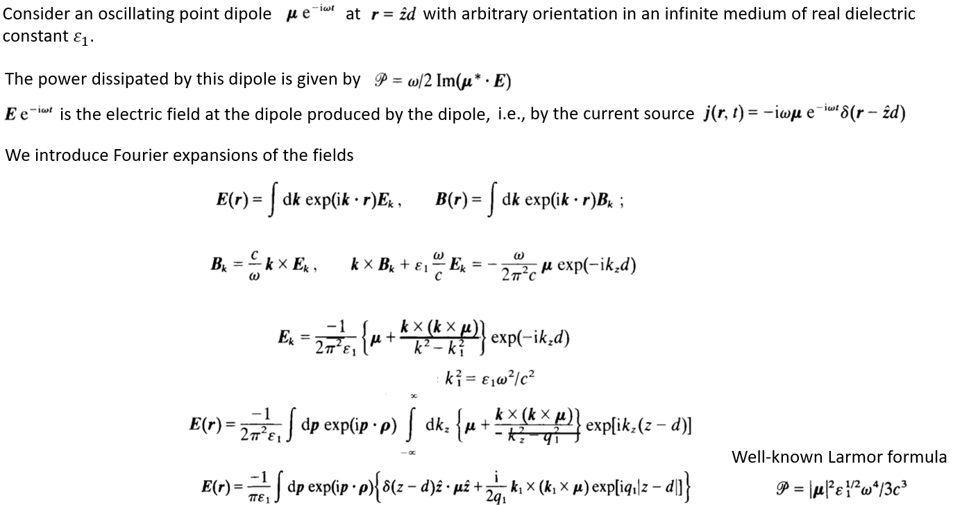
Point dipole above a semi-infinite metal

Slide 16
Point dipole above a semi-infinite metal
We now consider the extension of this result to the case when a metal (designated medium 2) is present in the region $z <0$.
To find the electric field at the dipole we first decompose the field in the region below the dipole into its P- and S-polarized components.
Using the vector identity
Field emitted from the dipole toward the metal can be written
The total field in this region is therefore

Slide 17
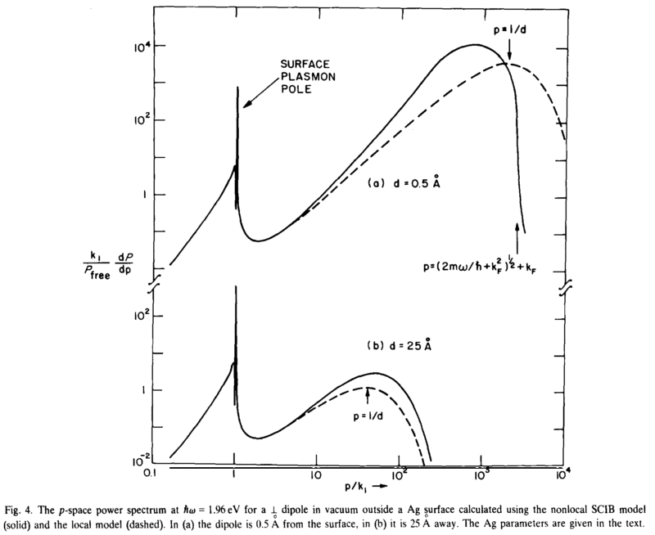
Point dipole above a semi-infinite metal
Lossy surface waves
Surface plasmon

Slide 18
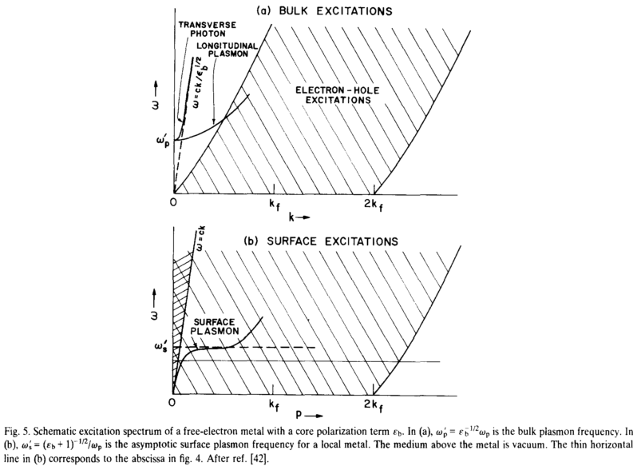
Local calculation does not describe electron—hole excitation, which dominates electron scattering loss in the high-p region.
The cutoff corresponds to the upper edge of the bulk excitation spectrum. The fact that beyond the cutoff the nonlocal result falls so dramatically is a consequence of screening of the electron scattering loss mechanism.

Slide 19
Summary
Key features of s-SNOM reproduced (qualitatively) in this example:
Nonlocality
Quasi-static
High q contribution (distance dependent)

