Slide 1
A Random Talk
4/7/2017

Slide 2
There is only one excuse for a speaker's asking the attention of his audience: he must have either truth or entertainment for them.
Dale Carnegie, Public Speaking for Success

Slide 4
When Warren Buffett was once asked about the key to success, he pointed to a stack of nearby books and said, “Read 500 pages like this every day. That’s how knowledge works. It builds up, like compound interest. All of you can do it, but I guarantee not many of you will do it.”

Slide 8
Commuting: (30 mins / day) × (5 days) = 2.5 hours
Exercising: (1 hours/ day) × (3 days) = 3 hours
House keeping: (30 mins / day) × (2 days) = 1 hours
Showering: (15 mins / day) × (7 days) = 1.75 hours
Cooking: (30 mins / day) × (7 days) = 3. 5 hours
Dog walking: (30 mins / day) × (3 days) = 1. 5 hours

Slide 9
‘’I read about 50 books a year.’’
Bill Gates

Slide 10
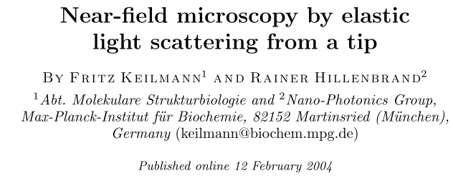

Slide 11
Point-Dipole Model
We assume that the probe is a polarizable sphere with dielectric value $ε_{t}$, radius $a≪λ$, and polarizability:
We further assume that the dipole induced in this sphere by an incident field $E_{i}$ can only point in the z-direction. The sample, which fills the half-space $z< 0$with dielectric value $ε_{s}$, is assumed to be polarizable only indirectly by the sphere’s dipolar field, but not directly by the incident field.
We then replace the sphere by a point dipole of equal strength and direction, located in the sphere’s center. In the electrostatic limit (no retardation considered) the near field between tip dipole and sample can be found by considering a ‘mirror’ point dipole inside the sample whose direction is parallel to the tip dipole, with polarizability $αβ$, where

Slide 12
Solving the system of electrostatic equations that describes the multiple interaction between tip and mirror dipoles yields an effective polarizability of the coupled tip–sample system which fully expresses the influence of the sample,
The scattering field from the coupled dipole system is $E_{s}∝ α_{eff}E_{i}$. It reveals that a sample affects the s-SNOM signal only through its dielectric value $ε_{s}$ taken at the wavelength of illumination.
$α_{eff}$ is complex and can be written as $se^{iφ}$. The s-SNOM image doesn’t measure the near-field scattering $α_{eff}= se^{iφ}$ directly. Rather, it maps the complex quantity $s_{n}e^{iφ_{n}}$ derived from it.
Consider the sinusoidal tapping motion between $z$ and $z+2∆z$ at frequency $Ω$, which induces a time-periodic scattering $α_{eff}(t).$ Because of the nonlinear dependence $α_{eff}(z)$ the scattering signal is modulated at harmonics of $Ω$. In general, the time course can be described by a Fourier series with $s_{n}$ and $φ_{n}$ being Fourier coefficients.

Slide 13
The detector measures the power $I ={ I}_{ref}+I_{s} +2{ I}_{ref}I_{s}cos(∆t+φ)$ generated by the interference of the strong reference beam and the weak, backscattered light from the probing tip. To measure both amplitude and phase the detector signal is processed in a high-frequency lock-in amplifier operating not at $∆$ but at the sum frequency $∆+nΩ$ (where $n$ designates the order of harmonic signal demodulation).
At sufficiently large $n$, the amplitude output signal is directly proportional to $s_{n}$ and the output phase to $φ_{n}$ measuring the pure near-field response

Slide 14
Near-Field-Induced Polariton Resonance
The highest s-SNOM amplitudes $s_{n}$ are predicted for materials with negative Re($ε_{s}$) ≈−1 and very small Im($ε_{s}$), which we call polariton-resonant materials. we predict that s-SNOM images will readily allow us to distinguish categorical material classes by amplitude contrast alone: polariton- resonant materials give exceptionally large signals, metals large signals, semiconductors medium signals, and low-index dielectrics low signals

Slide 15
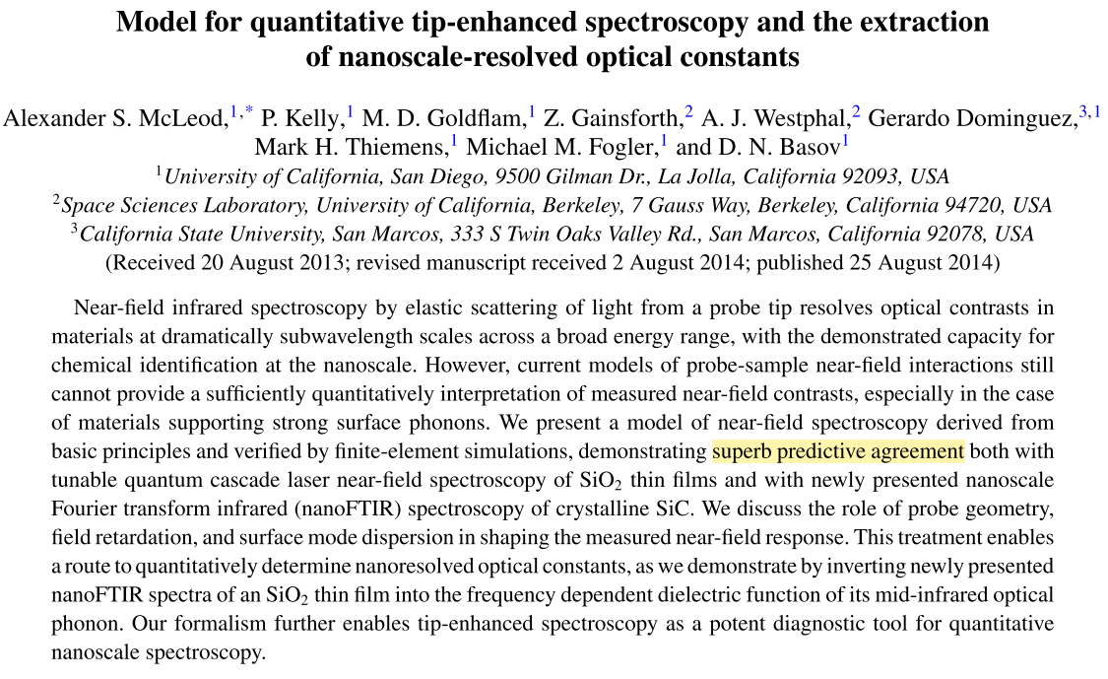

Slide 16
Lightning Rod Model
The charge distribution on probe . In the quasistatic approximation, the field $E_{rad}$ backscattered from the probe is proportional to its induced dipole moment
can be written as the sum of charges induced by the incident field and those differential contributions induced by reflection of probe-generated near-fields off the proximate sample:
denotes the induced charge per unit field resulting from incident illumination. Its functional form depends on the nature of the incident field and the probe geometry.
The induced charge elements take the form

Slide 17
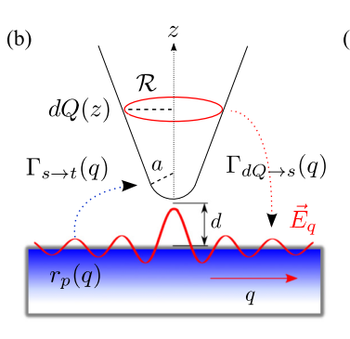
Charge elements on the probe form rings with radii along its surface.
Each ring emits a distribution of axisymmetric p-polarized evanescent fields whose Fourier components are weighted by
Sample response function

Slide 18
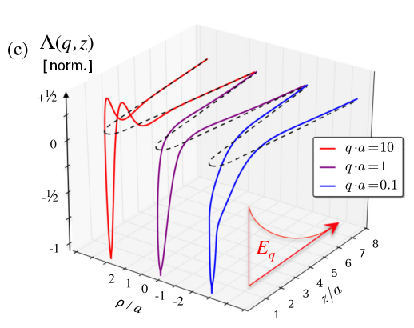
Induced charge densities can be precomputed for an axisymmetric probe of arbitrary geometry using a simple boundary element method.
The density of charge dramatically accumulating at the probe apex —the celebrated lightning rod effect—increases roughly as $1/q$.
Probe response function computed by the boundary element method for evanescent fields of increasing momenta q. Dashed curves indicate the geometric profile of the probe, and surface charge distribution profiles are normalized by their minimum values for viewing purposes.

Slide 19
This resembles the Lippman-Schwinger equation of scattering theory, wherein and here play the role of in- and out-going “scattering states.”
Provided knowledge of the probe response functions and above equation is soluble by traditional methods after discretizing q to a set of Gauss-Legendre nodes .
Only a finite range of momenta need be considered in practice, since drop precipitously in magnitude above a cutoff momentum s ∼ 1/a, with a the smallest length scale relevant to the probe geometry, in this case the radius of curvature at the probe apex.

Slide 20
The momentum-space solution is then
is the identity operator, and other matrices are defined as
Finally, this implies
Note that dependence on both the tip-sample distance d and the local optical properties of the sample enter these expressions through , whereas geometric properties of the probe enter separately through sd.

Slide 21
Simulating this technique, the probe’s backscattered field is connected to the experimentally observed amplitude and the phase signals through a sine transform under a sinusoidally varying tip-sample distance d:
denotes the frequency-dependent instrumental response of the collection optics, interferometer, and detector used for the measurement. This factor can be removed by normalizing experimental result to “reference” near-field signal values, as collected from a uniformly reflective sample material such as gold or undoped silicon.

Slide 22
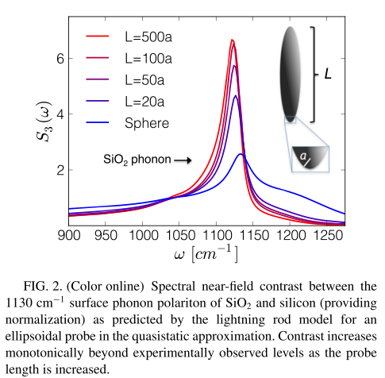

Slide 23
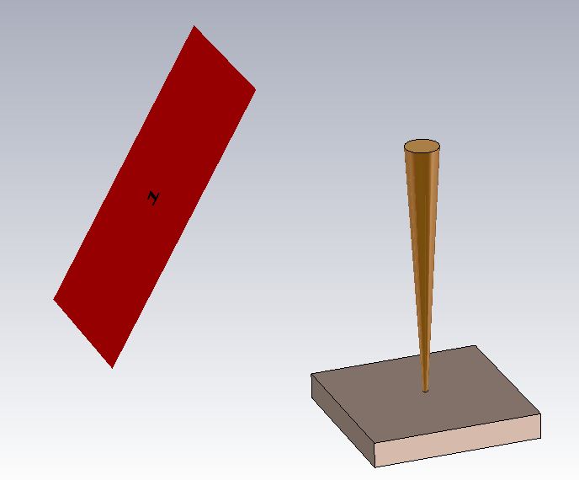
Near-Field Simulation with CST
Tip-sample distance $z=−A, −A+δz, −A+2δz, …, A nm$
shape
$$S11(ω,z)$$
L
$$z\left(t\right)=−Acos(Ωt)$$
r
t
$$S11(ω,t)$$
d
$$s_{n}(ω\text{)}\text{=}\text{I}\text{(}ω\text{)}\int_{0}^{\frac{2π}{Ω}}{dt\cos\left(nΩt\right)S11(ω,z)}$$

Slide 24
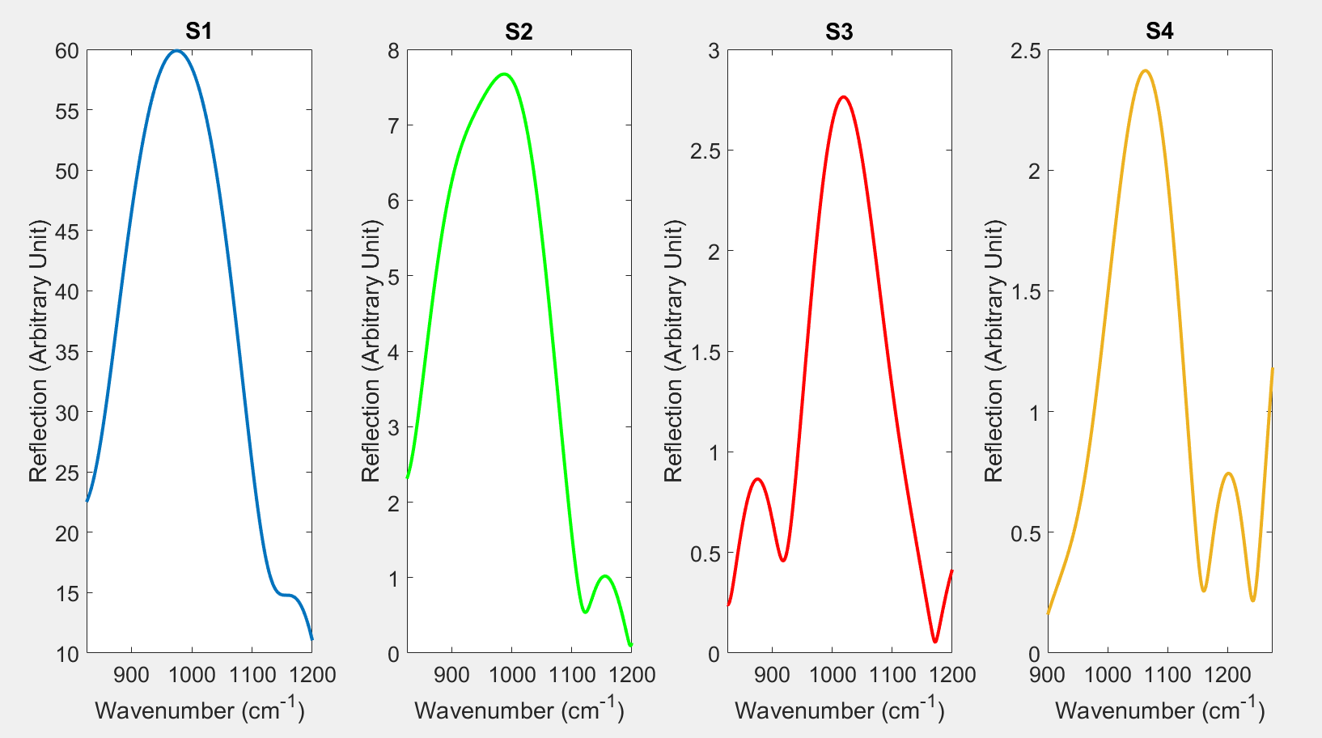

Slide 25
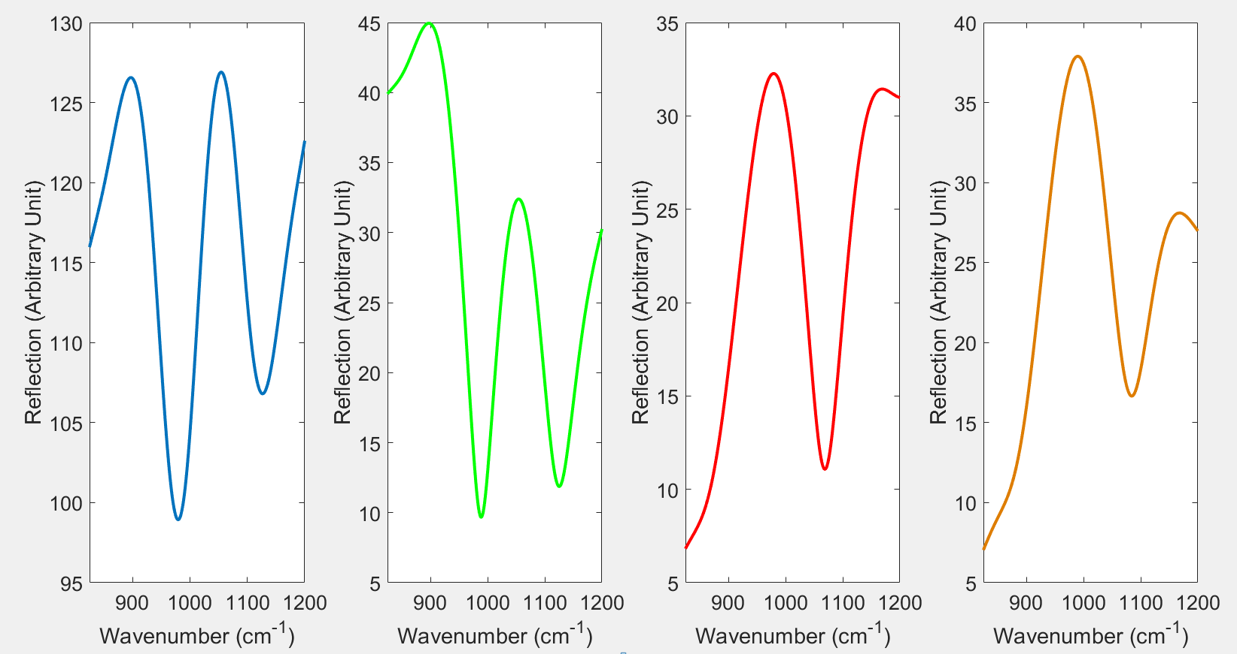

Slide 26
