Slide 1
KxFe2-ySe2

Slide 2
Alkali-doped iron selenide exhibits unique characteristics that are absent from other iron-based superconductors, such as
antiferromagnetically ordered insulating phase and the presence of Fe vacancy and ordering. The delicate interplay between Fe vacancy, magnetism, and superconductivity has generated a lot of excitement and confusion.
KxFe2-ySe2, a superconductor with Tc =32 K, was discovered in 2010. It separates into two phases, a dominant anti-ferromagnetic insulating phase K2Fe4Se5 and superconducting phase with unclear composition.
Li, W., Ding, H., Deng, P., Chang, K., Song, C., He, K., … Xue, Q. (2012). Phase separation and magnetic order in K-doped iron selenide superconductor, 8(February), 3–7. https://doi.org/10.1038/nphys2155
Ding, X., Fang, D., Wang, Z., Yang, H., Liu, J., Deng, Q., … Wen, H. (2013). Influence of microstructure on superconductivity in K, (May), 1–7. https://doi.org/10.1038/ncomms2913
Guo, J. et al. Superconductivity in the iron selenide KxFe2Se2 (0rxr1.0). Phys. Rev. B 82, 180520 (2010).
Fang, M. H. et al. Fe-based superconductivity with Tc¼31K bordering an antiferromagnetic insulator in (Tl,K) FexSe2. Europhys. Lett. 94, 27009 (2011).

Slide 3
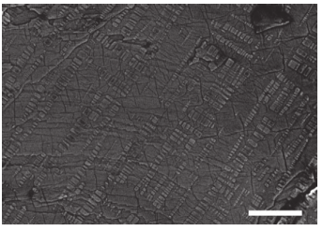
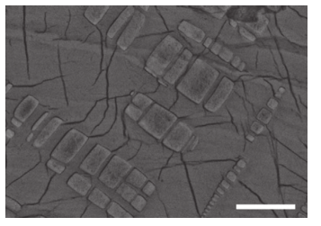
10 um
2 um
SEM measurements on cleaved surface
Ding, X., Fang, D., Wang, Z., Yang, H., Liu, J., Deng, Q., … Wen, H. (2013). Influence of microstructure on superconductivity in K, (May), 1–7. https://doi.org/10.1038/ncomms2913

Slide 4
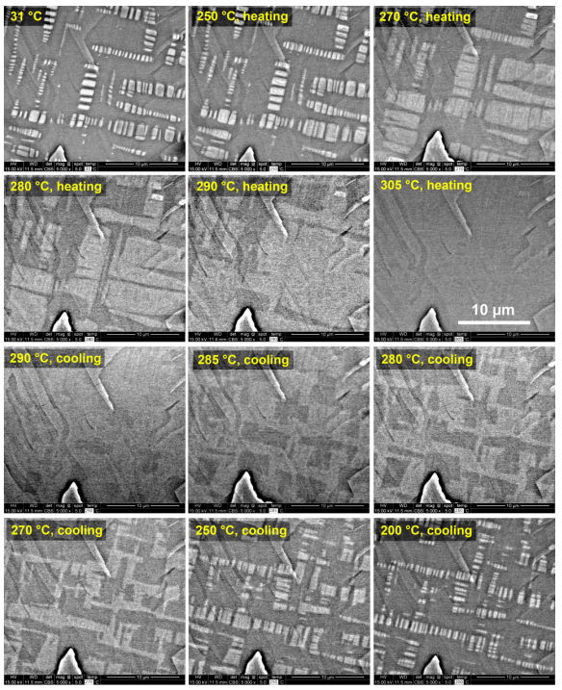
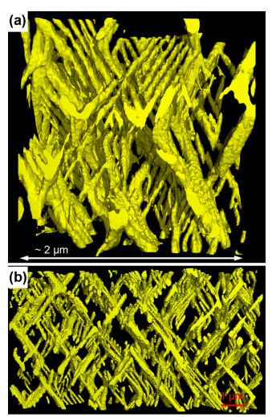
Reconstructed 3D morphology
SEM images at different T both heating and cooling
Liu, Y., Xing, Q., Straszheim, W. E., Marshman, J., Pedersen, P., McLaughlin, R., & Lograsso, T. A. (2016). Formation mechanism of superconducting phase and its three-dimensional architecture in pseudo-single-crystal. Physical Review B, 93(6), 64509. https://doi.org/10.1103/PhysRevB.93.064509

Slide 5
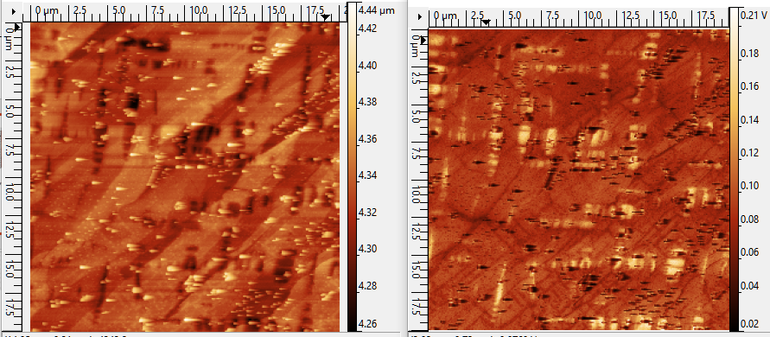
AFM
Near-field S2
20 um by 20 um

Slide 6
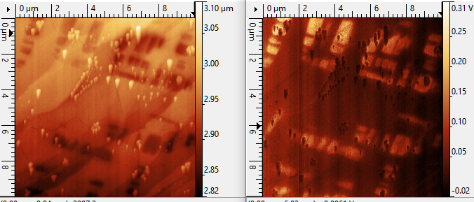
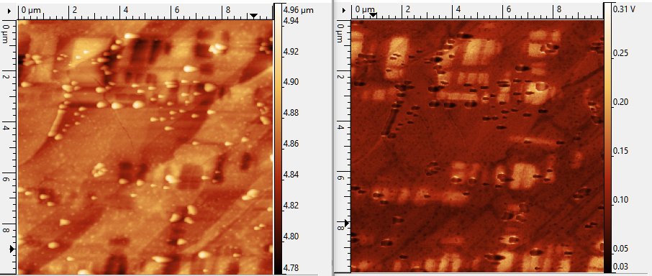
AFM
Near-field S2
AFM
Near-field S2
10 um by 10 um

Slide 7
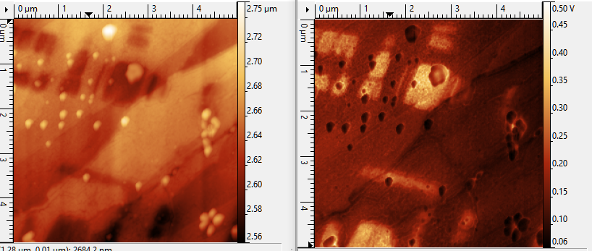
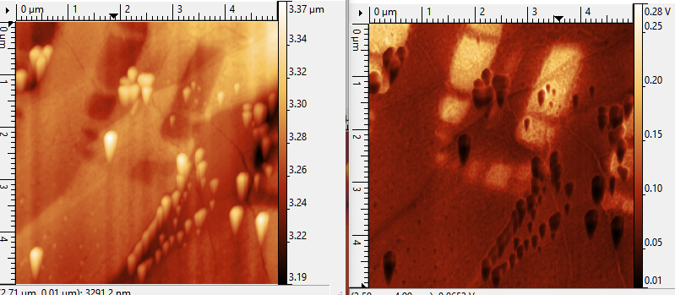
AFM
Near-field S2
AFM
Near-field S2
5 um by 5 um

Slide 8
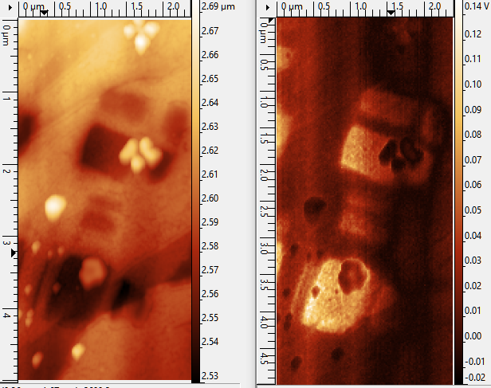
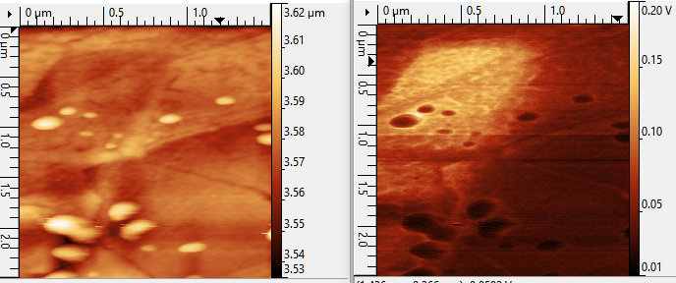
AFM
Near-field S2
1.5 um by 2 um
AFM
Near-field S2
2.5 um by 5 um

