Slide 1
A Random Talk
Mainly about Extraordinary Optical Transmission
7/14/2017

Slide 2
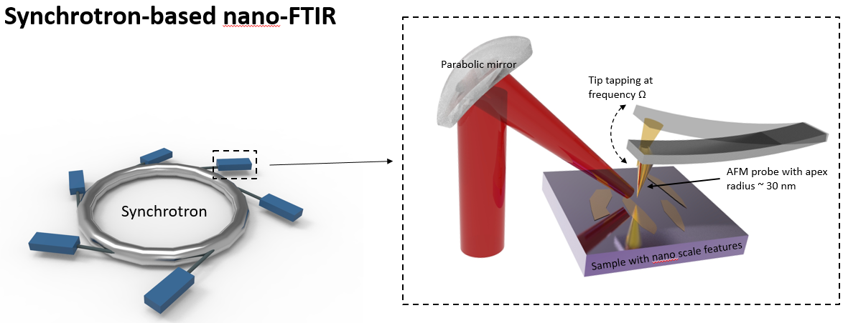
Sample List for ALS Trip
Sample Source | Sample Description | Measurement Plans | Time
Hu Hai | Ag pads with different thickness | On each silver pads On substrate | 2 days
Hu Hai | Au patterns on sapphire and SiO2 | Different polarizations On Large gold pad | 1 day
Cedomir | KFeSe superconductor | On superconducting domains On non-superconducting area Possibly high temperature | 1 day
Larry | Gold films | On insulating films On different topography | 1 day

Slide 3
Extraordinary Optical Transmittance (EOT)
Essentially, a metal film becomes semi-transparent at resonant wavelengths allowing the excitation of electromagnetic waves propagating on the surface of the film.

Slide 4
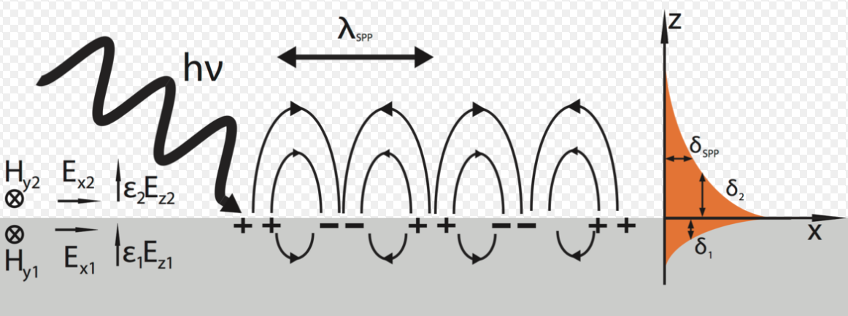
Surface Plasmon Polaritons
In the optical and infrared spectral ranges, the collective excitation of the electron density coupled to the electromagnetic field results in surface plasmon polaritons (SPPs) travelling on the metal surface.
The SPPs can be excited when the real part of the metal permittivity, , is negative and loss is relatively small, .

Slide 5
Surface Plasmon Polaritons
At the metal-dielectric interface, the SPP is essentially an H-wave, with the direction of the magnetic field H parallel to the metal surface [Landau et al., 1984].
In the direction perpendicular to the interface, SPPs exponentially decay in the both media.

Slide 6
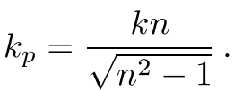
Surface Plasmon Polaritons
Assume that the half-space z < 0 is vacuum, . Neglect the metal loss for the metal half-space.
We seek solutions for the magnetic field H in the following form
where ,
boundary conditions, requiring that the tangential components of the magnetic field are continuous at z = 0.

Slide 7
Surface Plasmon Polaritons
z component of the electric field takes the following values on the metal interface:
On the vacuum side: .
On the metal side: .
This electric field discontinuity occurs due to the surface charge density
,
which propagates together with the electric and magnetic fields along the film surface.
The propagation speed , is always slower than the speed of light. This explains why the surface plasmon polaritons cannot be excited by an external electro- magnetic wave on a perfectly flat metal surface.
When n approaches 1 ( ), vanishes. In this case, the surface charge the normal component of the electric field diverge. This phenomenon is known as the plasmon resonance.

Slide 8
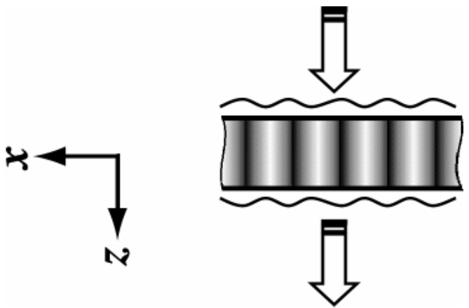
Surface Plasmon Polaritons
We consider now SPP propagation on a metal film of the finite thickness d. We are interested in the consequences of a strong skin effect so that the field decays exponentially in the bulk of the film.
Apply similar calculation: , where k1 and k2 correspond to the symmetric and the antisymmetric wavevectors of the SPPs.
The light incident on a modulated film. It first excites surface plasmon- polariton (SPP) on the front interface of the film, which then couples to the SPP on the back interface; the back-side SPP is eventually converted into the transmitted light.

Slide 9
Surface Plasmon Polaritons
These SPPs cannot be excited by an external electromagnetic wave incident from vacuum since that would violate the momentum conservation.
The situation changes dramatically when the film has a periodically modulated material properties. In this case, the EM field inside the film also gets modulated. When the spatial period of the modulation coincides with the wavelength of a SPP, it can be excited by an incident EM wave.

Slide 10
Extraordinary Optical Transmittance (EOT)
The extraordinary optical transmission (EOT) was discovered through nanohole arrays in optically thick metal films [Ebbesen et al., 1998], [Ghaemi et al., 1998], [Kim et al., 1999], [Thio et al., 1999], [Grupp et al., 2000], [Martin- Moreno et al., 2001].
By numerical simulations, local EM field was strongly enhanced in subwavelength apertures for certain frequencies. This enhancement is considered to be the reason for the enhanced resonant transmittance.
Debates arise because the distributions for the local EM fields vary significantly in the simulations performed by different authors.

Slide 11
Extraordinary Optical Transmittance (EOT)
The extraordinary optical transmission (EOT) was discovered through nanohole arrays in optically thick metal films [Ebbesen et al., 1998], [Ghaemi et al., 1998], [Kim et al., 1999], [Thio et al., 1999], [Grupp et al., 2000], [Martin- Moreno et al., 2001].
By numerical simulations, local EM field was strongly enhanced in subwavelength apertures for certain frequencies. This enhancement is considered to be the reason for the enhanced resonant transmittance.
Debates arise because the distributions for the local EM fields vary significantly in the simulations performed by different authors.
Potential CST investigation?

Slide 12
Extraordinary Optical Transmittance (EOT)
Two theoretical papers ([Martin-Moreno et al., 2001] and [Popov et al., 2000]) claim the connection of EOT to SPPs. Two simulation works ([Lalanne et al., 2000] and [Cao and Lalanne, 2002]) claim EOT is related to plasmon modes rather than SPPs.
It was also proclaimed by [Lezec and Thio, 2004] that SPP has nothing to do with EOT since this phenomenon is due to the excitation of the special evanescent waves that are generated by interaction of the incident light with holes, rings, and other nonuniformities on the metal surface.

Slide 13
Extraordinary Optical Transmittance (EOT)
After almost ten years of intense research and despite a convergence of views, no global consensus exists.
We cannot even give unambiguous answers to the very basic questions: How large can the enhancement of the resonance transmittance be? Does EOT exist indeed?

Slide 14
Summary and Thoughts
Analysis on EOT and SPP is done only in periodic structures.
Transmittance only gets enhanced at certain discrete frequencies.
Film thickness considered is in the order of 10 µm.
The relationship between EOT and SPP is still under debate.

