Slide 1
A somewhat random talk mainly about transfer matrix
9/22/2017

Slide 2
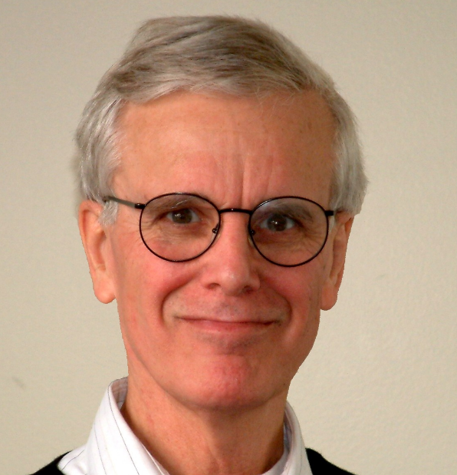

Slide 5
Don’t sue me please!

Slide 49
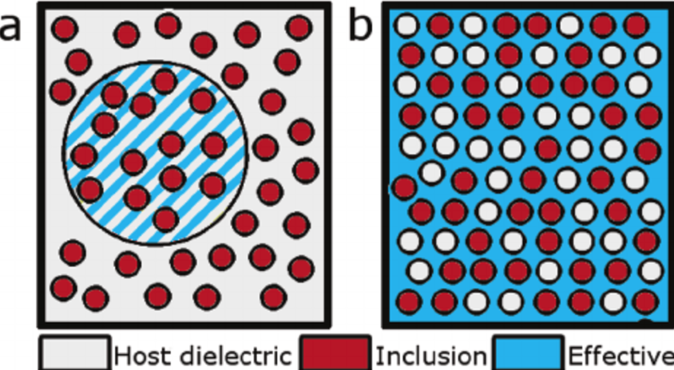
Effective medium theory Zhijing 9.29.2017

